Slide 1

Keeping
Your Laboratory Fully Staffed
WDL Successes
Mike Baron, MBA, MS, C (ASCP)
Executive Director Clinical Laboratory Operations

Slide 2


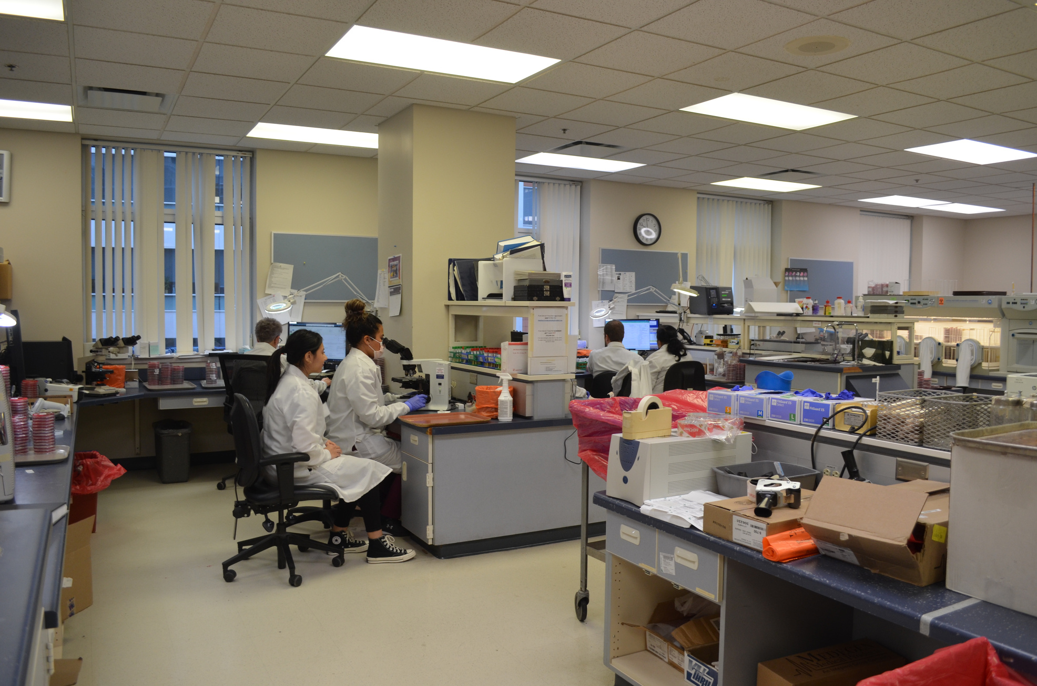
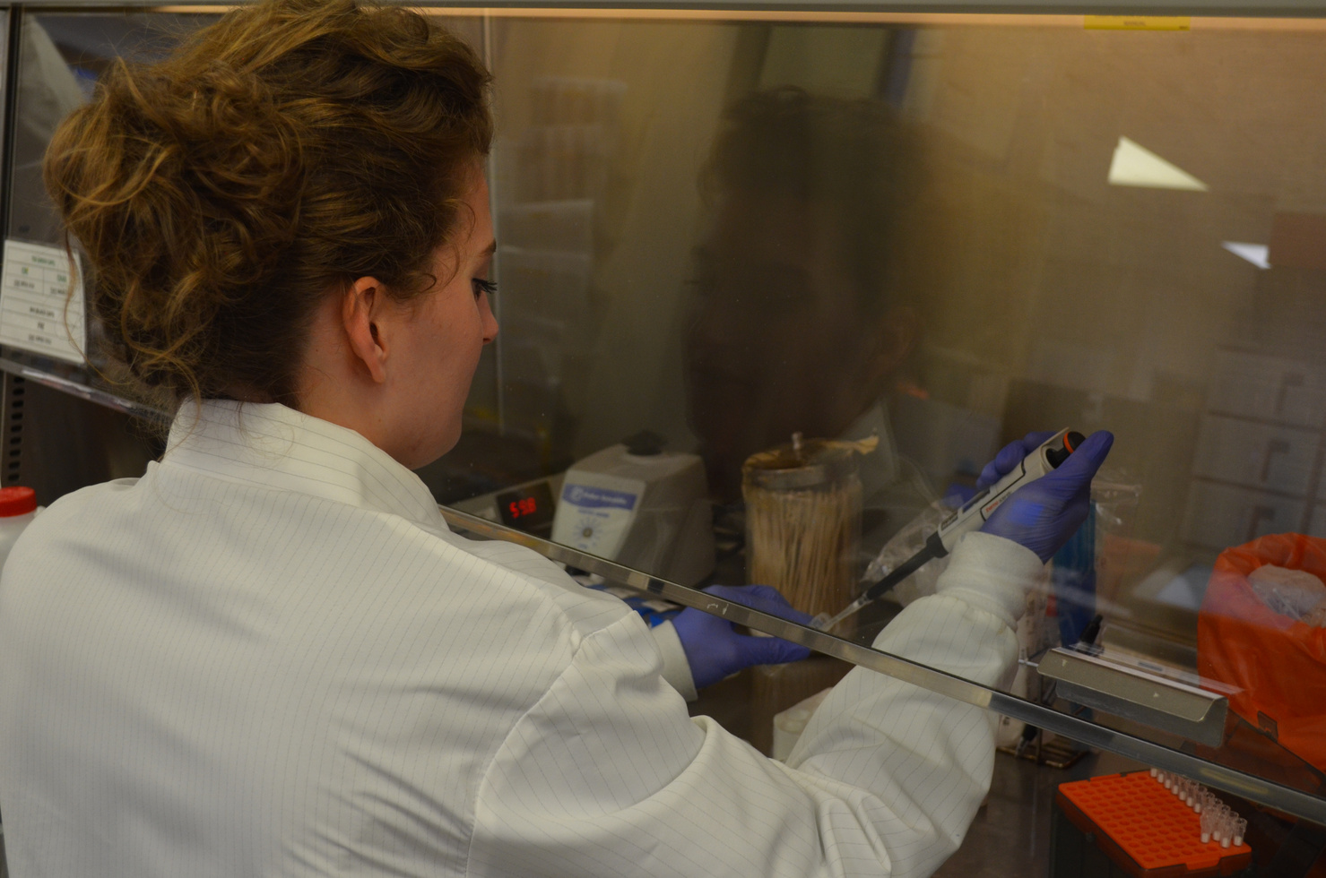
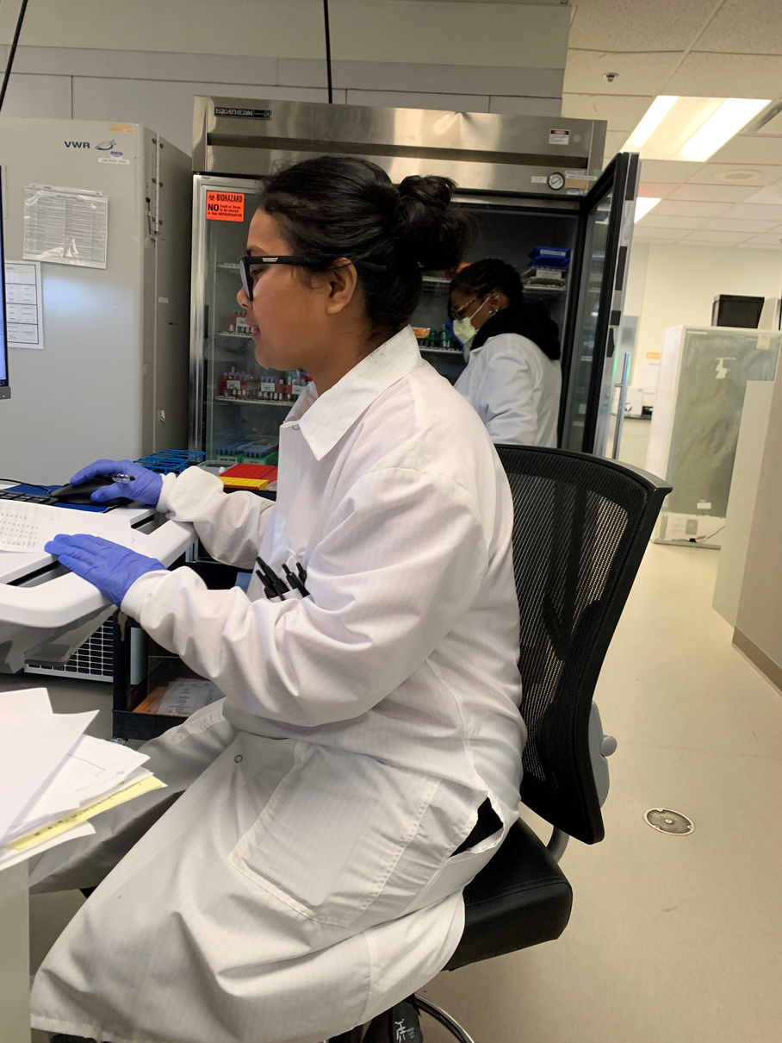
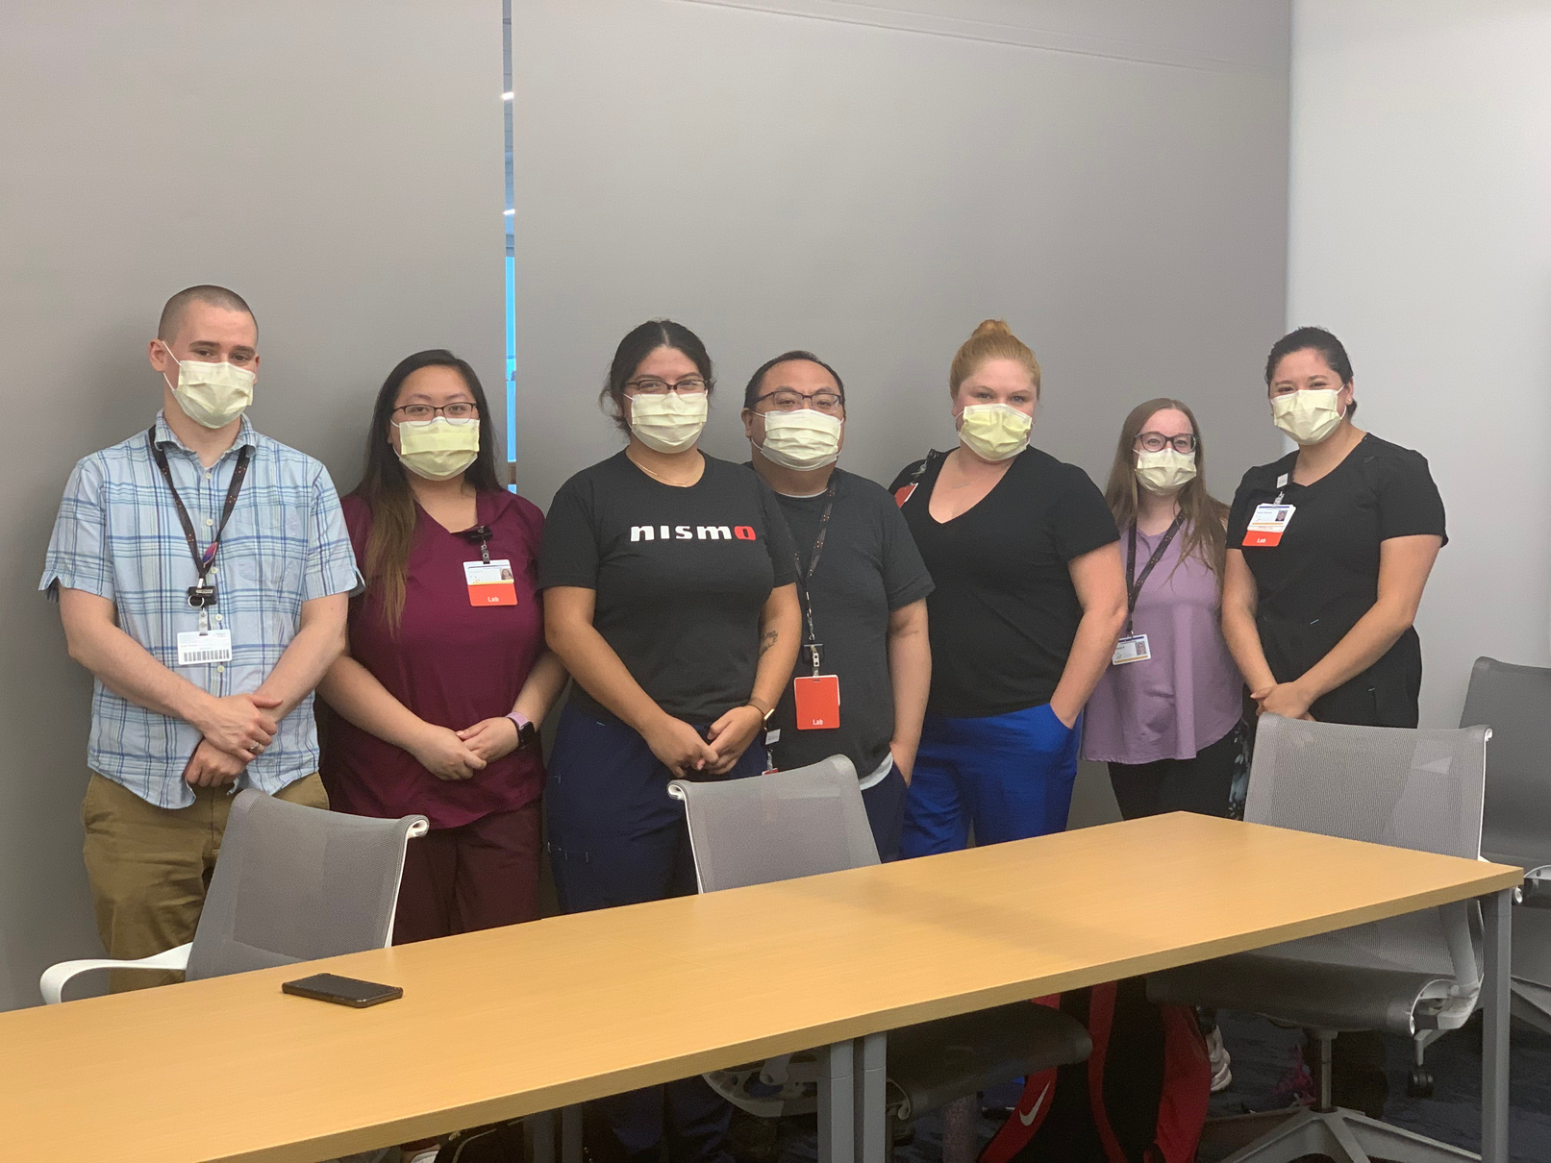
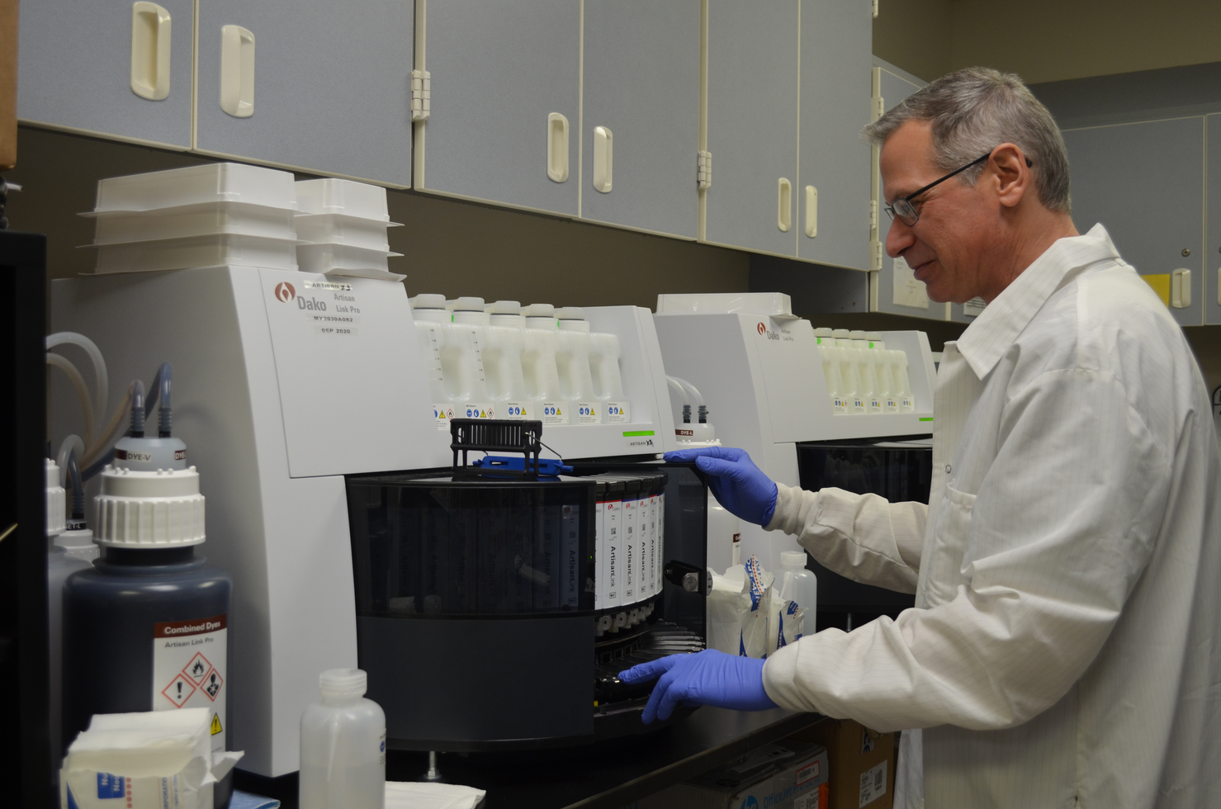
Meet Your Staffing Needs
WDL Development Options
State Apprenticeship
On-site Development

Slide 3

Key Agenda Topics
Attracting Quality Lab Members
Non-Certified Tech Program
Apprenticeship Program
Training Commitment and Resources
MLA Program Development
Increasing Career Awareness
Partnership – WDL and MATC

Slide 4


Developing a
Non-Certified Technical
(NCT) Staff Program

Slide 5
WDL Development Programs
Clinical Pathology
Anatomic Pathology
  Non-Certified Technologist (NCT)
    Chemistry
    Cytogenetics
    Hematology
    Microbiology
    Molecular Biology
    Blood Bank
  Medical Laboratory Assistant (MLA)
  Histotechnician (HT)
  Histotechnologist (HTL)

Slide 6
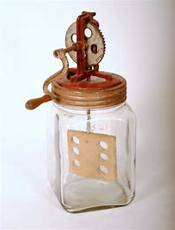
Attracting Qualified Lab Team Members
1.Traditional - Certified Medical Lab Tech Programs
2. NCT - Candidate Meeting CLIA Requirements
  Science Bachelors Degree
  Transcript Verification
3. On-the-Job Experience in Clinical Lab
4. Provide Education in the Laboratory
5. Preparing for Certification
6. Achieving ASCP Certification
Churn is the New Norm
We needed to brainstorm innovative training solutions to address our growing staffing needs and meet our high volume demands.

Slide 7

Non-Certified Tech (NCT) Program
Recruiting Graduates – Bachelor Degree meeting CLIA Requirements
Paying the candidate – role Non-Certified Tech
Training the candidate
  On-the-job training & achieve competency
  Providing classroom instruction
  ASCP certification preparation support
One Year ASCP Certification eligible
5. Expected to gain ASCP Certification (24 to 30 months)

Slide 8

NCT - PROs and CONs
PROs
Noting a good candidate pool – select the best from many
Candidate education background facilitates quick learning
Entry pay until achieve certification
Noting good success with transition into clinical laboratory
CONs
Not produce generalist, focus on one or two specialties
No guarantees the candidate will stay after training completed

Slide 9
NCT Program vs. Apprentice Program
Development of a NCT Program | Medical Laboratory Technologist Apprentice Program
Provide In Lab Classroom Instruction for NCT – Lab Trainer role | Supported through your State Apprentice Programs
Classroom Instruction can follow along with the on job experience | Partnership with local college for classroom instruction (MATC)
Candidate is eligible for ASCP Certification after one year | Candidate can complete classroom instruction over two college semesters
Pay candidate for time in classroom (expect studying after hours at times) | Pay candidate tuition, books and parking fees

Slide 10
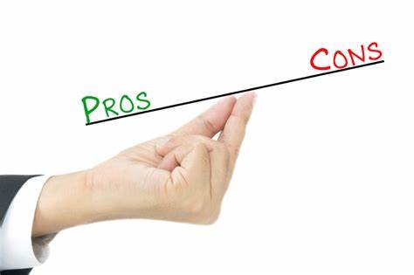
Apprentice Program - PROs and CONs
PROs
Classroom instruction by college supports on-the-job (OJT) training
Laboratories can get monies from state for participating (up to $3,500 to offset tuition costs)
CONs
Limited class start times – beginning of school semester schedule
School training less flexible and not necessarily follow along with OJT

Slide 11

Development of NCT Program
Benefits:
Allow lab to fill ranks quickly – immediately fill staff shortages
Training can focus on your specific lab needs
Much flexibility with training time and meet operational needs
Can begin in pre-analytical processing area to gain knowledge of LIS, specimen types and specimen requirements
Drawbacks:
Much time to dedicate to classroom instruction
Need to identify and dedicate an Instructor for classroom instruction
Initial acceptance of current lab team members

Slide 12
Development of Classroom Instruction
WDL Lab Trainer - Patty Boyer
Core lab focus – Instruction for chemistry and hematology
Develop learning objectives and map assessments to these objectives
Development of classroom presentations and assessments
Select supporting textbooks and other resource materials
Schedule and conduct classroom instruction
Supporting student needs with competing responsibilities
Rotating in new NCT candidates

Slide 13
NCT Program - Candidate Perspectives
PROs
Obtaining employment in a career field that will have many career opportunities
Gaining job satisfaction with helping patients
CONs
Initial difficulty understanding laboratory unique verbiage
Encountering technical staff frustration with need to go into more details with instruction/learning process

Slide 14

NCT Program – Dept. Manager Perspective
PROs
Helped fill long-standing open positions
Hands on training provide from experienced technical staff
Provides support to theoretical learning
Less need to mandate technical staff due to staffing shortage
CONs
Initially NCT unfamiliar with clinical terminology
NCT required extra attention from technical trainers
Concern of burn out from tech trainers with continuous training of students and extended NCT training

Slide 15
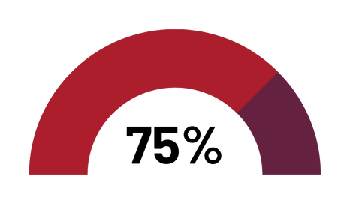
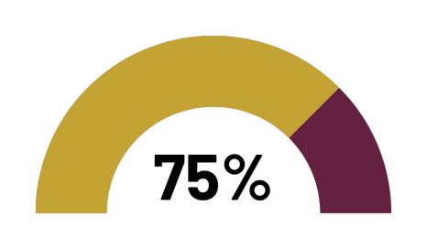
Consider the Return On Investment
  Set Goals
  Plan for a longer training period
    Same competencies expected
    Need background information
    No previous clinical experience
  Set expectations upon hire
    Will certification be required?
    Must be >12 months due to ineligibility timeframe
  Monitor Retention
    Set a goal
Goal: > 75% pass certification exam
Goal: >75% stay 1 year post certification

Slide 16
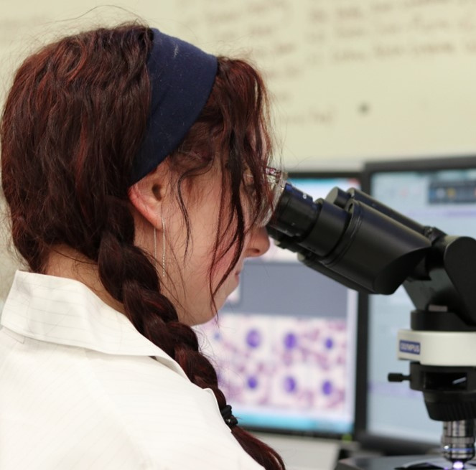
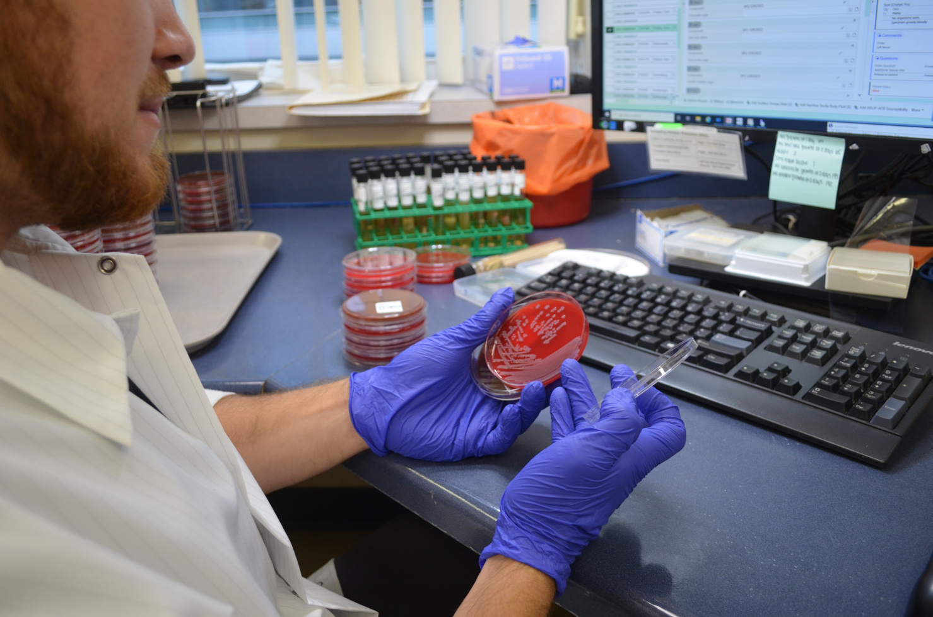
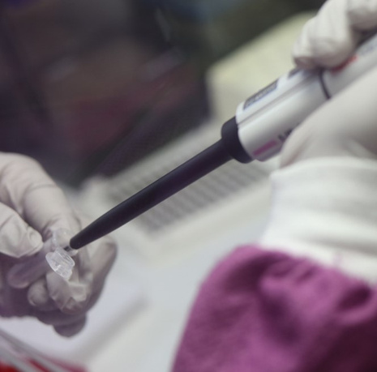
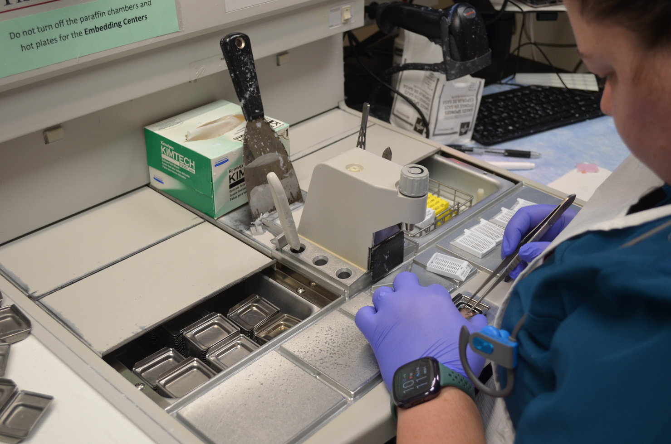
WDL Certification Success Stories: 2021-2026
Microbiology & Molecular Biology
Hematology
Anatomic Pathology
Cytogenetics
12 Hematology Technologists (H)
3 Cytogenetics Technologist (CG)
Chemistry
15 Technologists (M) & (MB)
7 Chemistry Technologists (C)
5 Histotechnician (HT)
3 Histotechnologists (HTL)
Notes:
Updated heme and chem numbers

Slide 17

WDL Certification Data
Number of staff who passed BOC exam between 12-30 months of hire since 2023
 | ASCP Posted Certification Pass Rates | ASCP Posted Certification Pass Rates | WDL Certification Data | WDL Certification Data | WDL Certification Data | WDL Certification Data | WDL Certification Data | WDL Certification Data | WDL Certification Data
Department | 2024 | 2024 | 2023 | 2024 | 2025 | # NCTs passed on 1st attempt | % NCTs passed on 1st attempt | # NCTs pending exam | # of Passing Repeats / Total Repeat Attempts
Hematology | 64% | 58% | 3 | 2 | 7 | 9/12 | 75% | 0 | 3/3
Chemistry | 40% | 44% | 1 | 5 | 1 | 4/7 | 57.1% | 2 | 3/4
Microbiology and Molecular Biology | M-59% MB-63% | M-56% MB-65% | 7 | 8 | - | 9/15 | 60% | 11 | 6/6
Anatomic Pathology | HT-57% HTL-63% | HT-62% HTL-67% | 1 | 2 | - | 2/3 | 66.7% | 1 | 1/1
Cytogenetics | 69% | 73% | - | - | 1 | 1 | 100% | 2 | 0/0
Notes:
Updated hematology and chemistry numbers

Slide 18

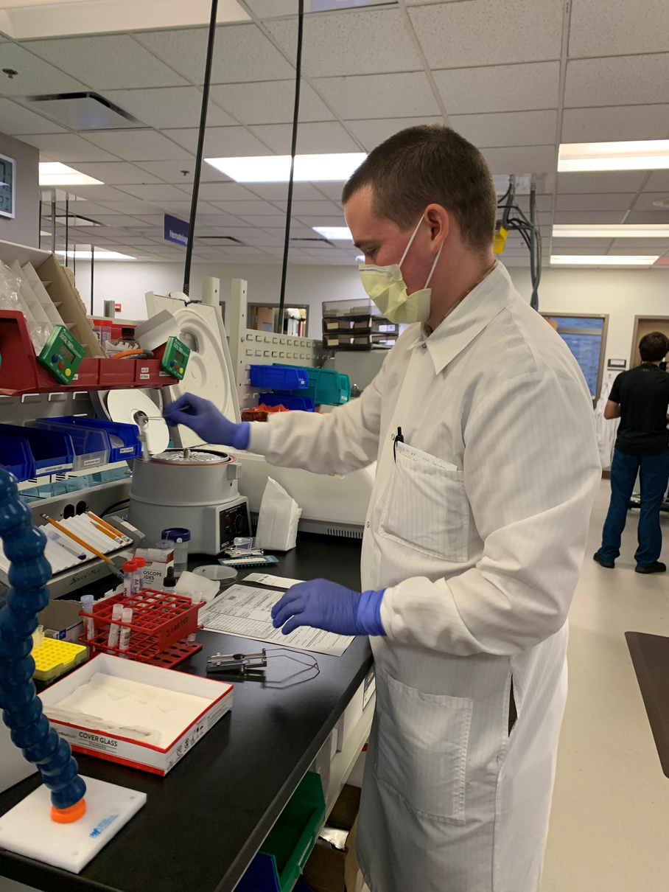
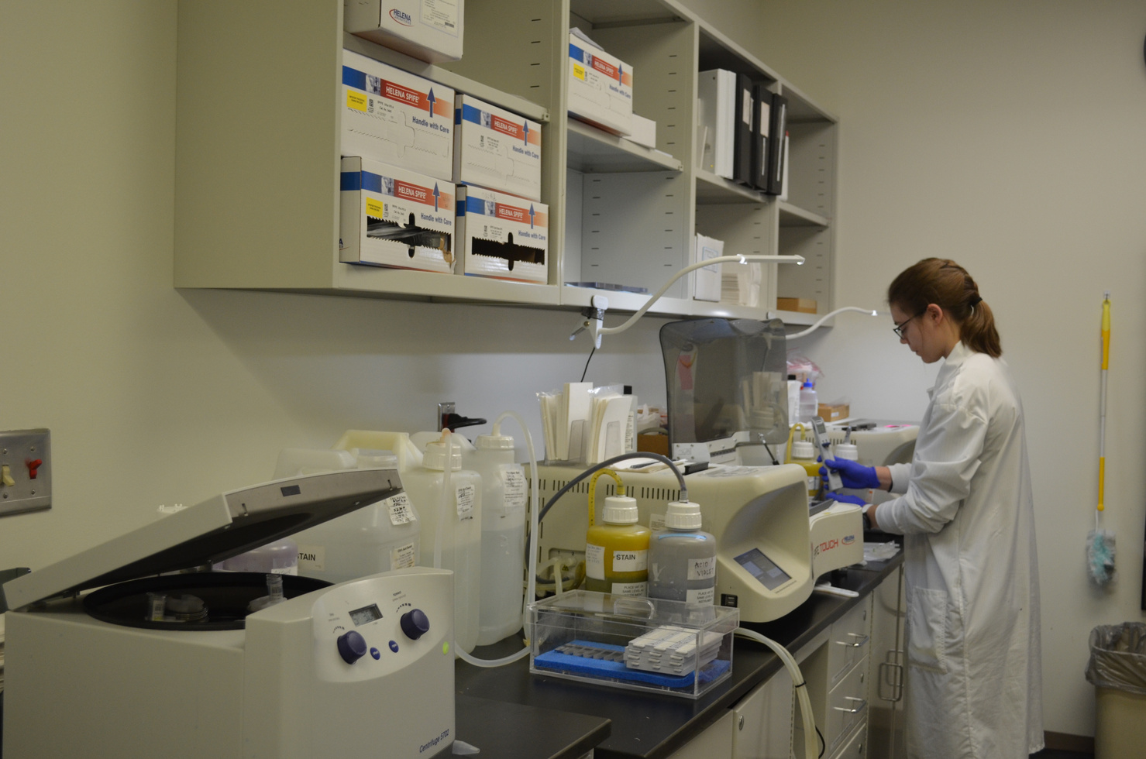
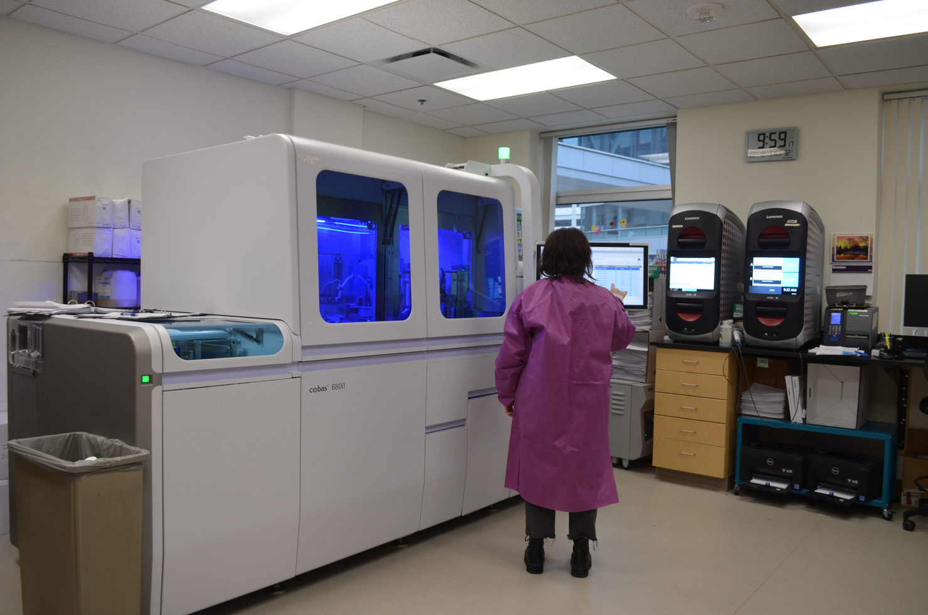
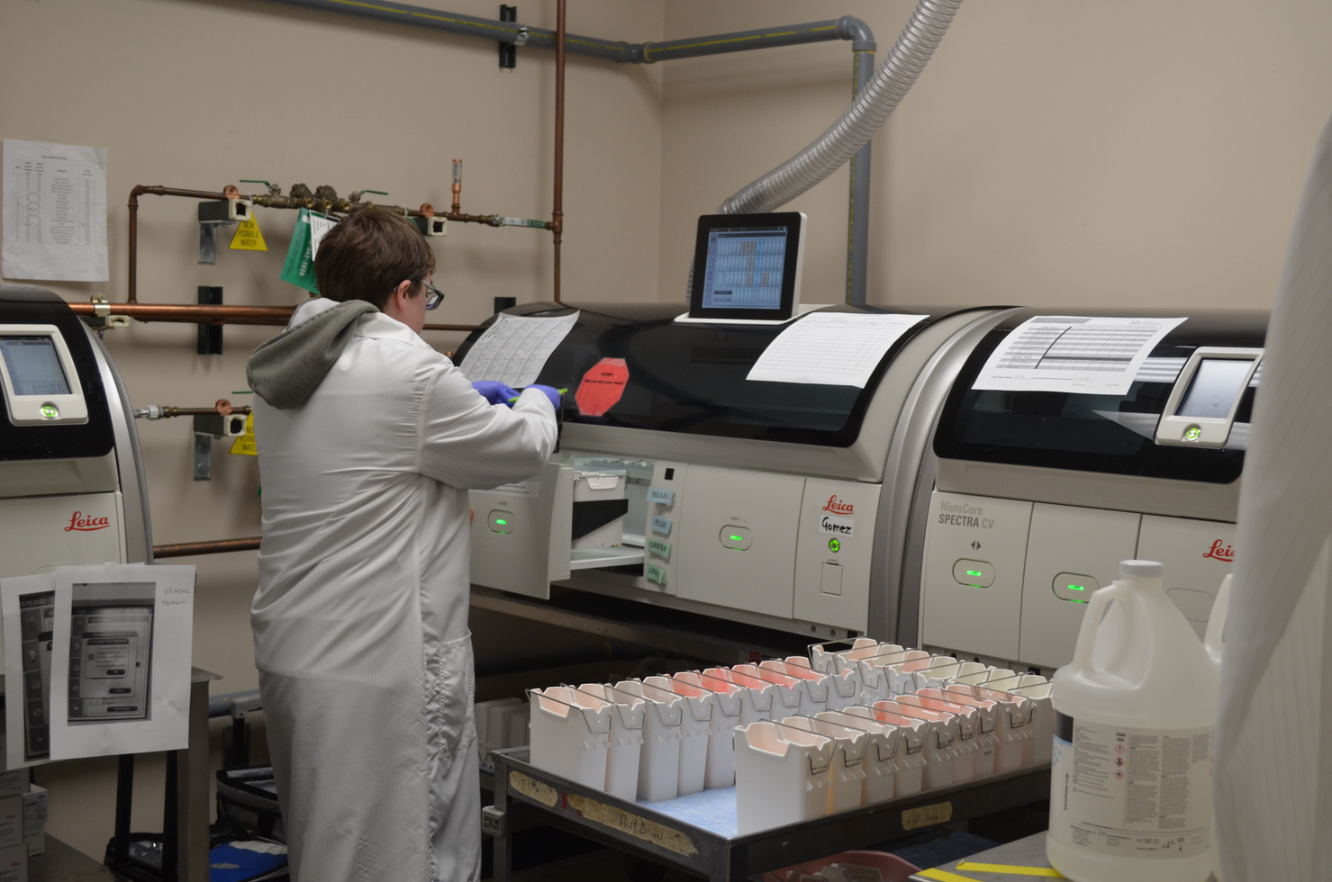
WDL NCT to Certified Retention Data
Indicator: WDL Developed Techs who remained employed > 1 year post certification
Hematology
Chemistry
Micro & Molecular
Anatomic Pathology
100% Retention LTAs
3 trainees are FTE at WDL
1 trainee - casual WDL, FTE at MCW
100% Retention
100% Retention
80% Retention NCTs hired since 2022

Slide 19

WDL and MATC Collaboration MLS
Built an MATC Relationship – Serve on Clinical Lab Advisory Board
Pursuit of Alternative Partnership
Clinical Laboratory Interest and Pulled in Workforce Development
Proposed a shared classroom & Gained other laboratories Interest
Laboratories fill classroom with candidates – NCTs
MATC provide Instructors and Classroom Instruction
Promoting online classroom – allows expanding program across state
Training Instruction in Sections – Can develop single specialty, multiple specialties and generalist
Program encourages and supports certification of candidates

Slide 20
Developing a
Medical Lab Assistant
(MLA) Staff Program

Slide 21

Medical Laboratory Assistant Program
Requires High School Education – prefer prior lab experience
Develop Classroom Instruction to teach basic lab skills
Immediate help in lab & candidate gain pay as a Lab Assistant
Can pick up many lab duties to free up technical team members
Lab will require less Technical team members to support operations
Program goal is for candidate to gain Lab Assistant certification, class room instruction to support this team member on this goal
Encourage Member further development and additional education

Slide 22

MLA Exam Eligibility Requirements
High School Diploma or Equivalent and Work Experience
    Specimen preparation and processing
    Support for clinical testing
    Laboratory operations
Optional Approaches:
  Accredited Educational Program: MLA or CLA
    200 Didactic hours
    120 hours clinical experience
  Associates Degree
    Six (6) Semester hours in Chemistry
    Six (6) Semester hours in Biology
  Military Laboratory Training Course
    50 Weeks
Accredited Clinical Laboratory
  CMS CLIA certificate
  DoD CLIP certificate
  JCI accreditation
  ISO 15189
Work Experience
Six to 24 Months

Slide 23

Medical Laboratory Exam Content
Pre-Analytical Considerations
  Patient Registration
  Specimen Collection
  Specimen Processing and Preparation
Analytical Considerations
  Support for Clinical Testing
  Waived and POC Testing
Laboratory Operations
  Laboratory Safety
  Quality
  Patient Test Management

Slide 24
Provide Certification Support
Classroom Instruction
Rotate Work Areas
Resources (Study Materials)
Continuing Education

Slide 25

MLA - Successful Exam
AMT
200 Questions
Minimum Passing: 70/100 (Scale 0 to 100)
ASCP
100 Questions
Minimum Passing 400 (Scale 0 to 999)

Slide 26
MLA – Manager Perspective Benefits
Microbiology/Molecular Manager – Jo Mentzer
Select From Qualified Team Members
Free up Technical Team
Encourages Further Development

Slide 27
Medical Laboratory Assistant Responsibilities
Specimen Management
Sample Loading, Validations and Lot Comparisons
Micro Culture Set up
Slide Preparation and Staining
Supply Management
Ordering & Rotating Supplies
Instrument Inventory
Reagents & Supplies
Kit Testing – waived
Maintenance
Cleaning
Temperature Monitoring
Waste Removal

Slide 28
MLA - Manager Perspective on Candidates
Pre-Analytical Manager – Jonathan Smith
Prefer Prior Lab Experience
  Current Staff Considerations
    Specimen Processors
    Phlebotomists
MLT and MLS Students
Positive Impacts to the Department
  Support Growing Staffing Challenges
  Address Large Workload

Slide 29
Increasing Student Awareness
Middle School and High School Connections – IGNITE, INSPIRE, STEAM and LAUNCH
Go to the Schools and Present about Clinical lab career & Hands-on Activities
Create Flyers sharing Information about Lab Careers
School Field Trips – Lab Tours and Hands-on Activities, Experience the Laboratory
Open our doors to support MLT/MLS Local College Programs – Student Interns
Reach Out through Social Media – Share Information and Videos
HOSA – Future Health Professionals – Conference Booth, Be a Sponsor, Judge, Speaker & Scholarship
ASCLS Conference – Speaker and Exhibitor booth
Support Lab Youth Apprenticeship Programs with State & High Schools
WSCA – School Counselor Conference, Counselors must know about Clinical Lab Careers
WCLN – Wisconsin Clinical Laboratory Network - Speaker
WSLH – Wisconsin State Laboratory of Hygiene – Communications Source Reach through State
High Schools, Colleges and Local Job Fairs – Presenting Lab Career
University/ Colleges Partnerships (Examples - MATC, UWM, Valparaiso)

Slide 30
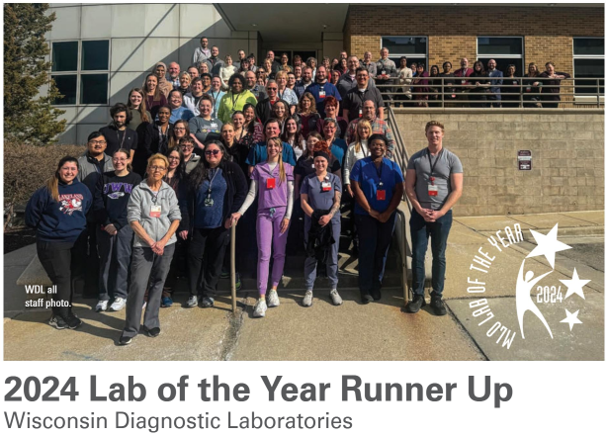
Build Your Reputation
  Create a Network
  Student Engagement

Slide 31








Create a Network
Annual Meetings
Committees
Education Boards
National Committees
Social Media

Slide 32
Promote the Profession
Job Shadow Opportunities
Student Tours
Career Day Events and Presentations

Slide 33
Job Shadows
We offer job shadow opportunities to students (high school or college) and college/university graduates who are looking to know more about the clinical laboratory.
  One-on-one shadowing with a staff member
  May request to observe several different departments
  Job Shadow Requests for 2024-2025
    Clinical Pathology - Blood Bank, Chemistry, Hematology, and Microbiology
      2022 - 2
      2023 - 3
      2024 - 9
      2025 - 8
    Anatomic Pathology - Histology or Pathology Assistant
      2024 - 3
      2025 - 2

Slide 34
Student Tours and Activities
MCW’s Ignite program brings in students from local middle and high schools to gain exposure to healthcare staff members in various roles within the health system.
  Career panel question and answer sessions
  Hands on activities
    Student Lab Tours
      2024 - 9 panel invites
      2025 - 6 panel invites
      2025 – 1 panel invite
      2026 – 2 panels with potential for 5 more this year
    Junior Achievement Participation in 2025: 1

Slide 35
Career Day Events/Presentations
WDL participates in local Career Day Activities and Events that take place at local high school or middle schools.
  Greenfield High School Hands-on-Healthcare
  Milwaukee Academy of Science
  STEAM Milwaukee – 5 events reaching ~200 middle school students
  Waukesha County Business Alliance – Health Care Expo, over 1000 students registered
  Waukesha North High School
  Wisconsin Lutheran High School
  Nicolet High School
  Carmen Schools of Science & Technology
Notes:
Thousands of students in the Milwaukee and Wisconsin areas

Slide 36
Exhibit at Conferences
WDL participates in Wisconsin-area conferences for guidance school counselors, teachers, and students.
  Wisconsin School Counselor Association
  HOSA-WI State Leadership Conference

Slide 37
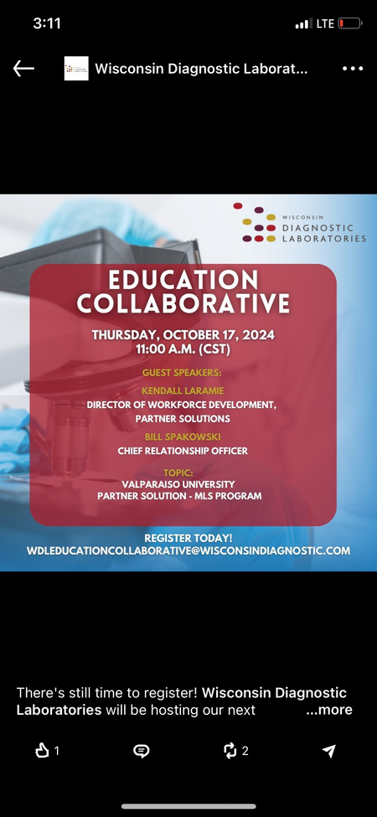
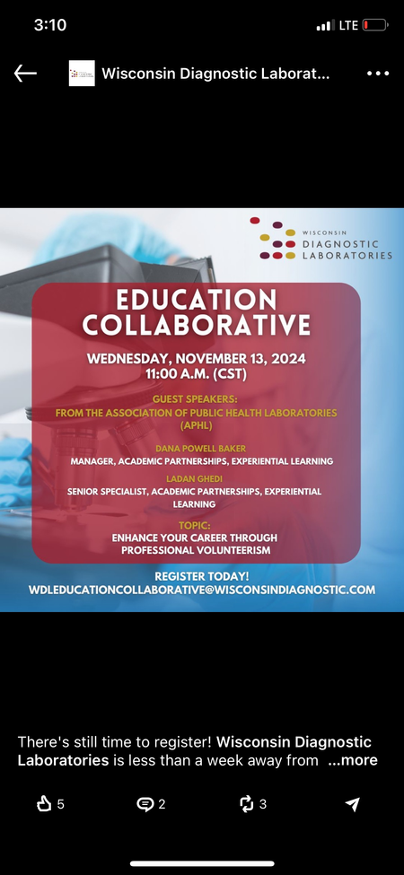
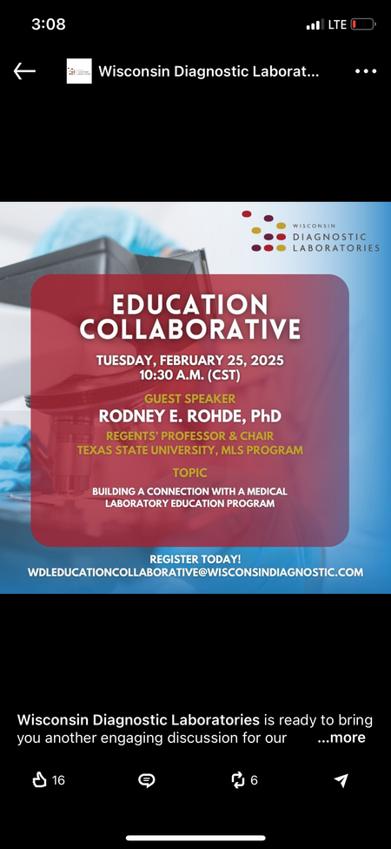

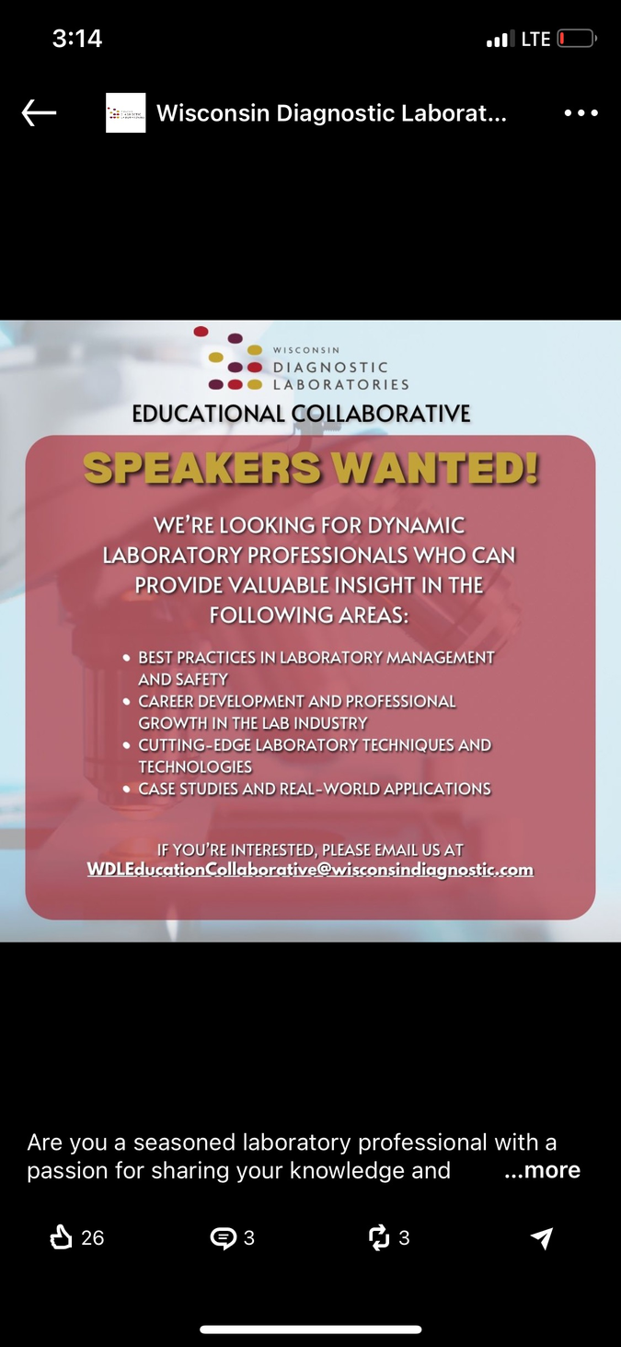
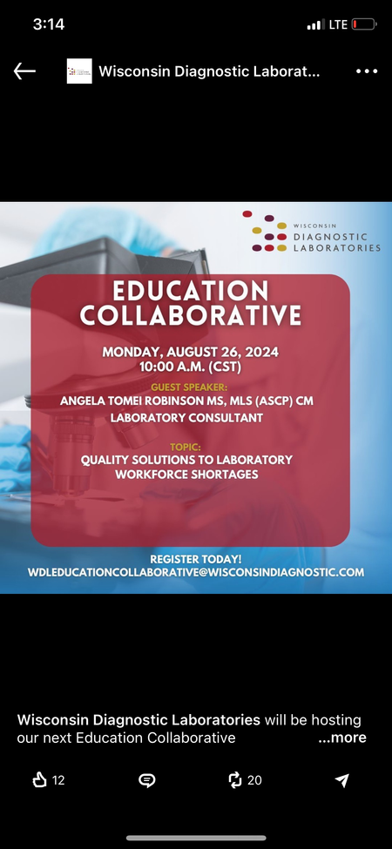

Want to Connect?
*Check out the WDL Education Collaborative*
A National Lab Network created to share alternative staffing and education solutions to meet the growing challenges associated with addressing staffing shortages in the clinical laboratory.
Interested participants can follow WDL’s LinkedIn Page to see upcoming events or register by email to WDLEducationCollaborative@wisconsindiagnostic.com

Slide 38
Key Topic Summary
Attracting Quality Lab Members
Non-Certified Tech Program
Apprenticeship Program
Training Commitment and Resources
MLA Program Development
Increasing Career Awareness
Partnership – WDL and MATC

Slide 39


Slide 40
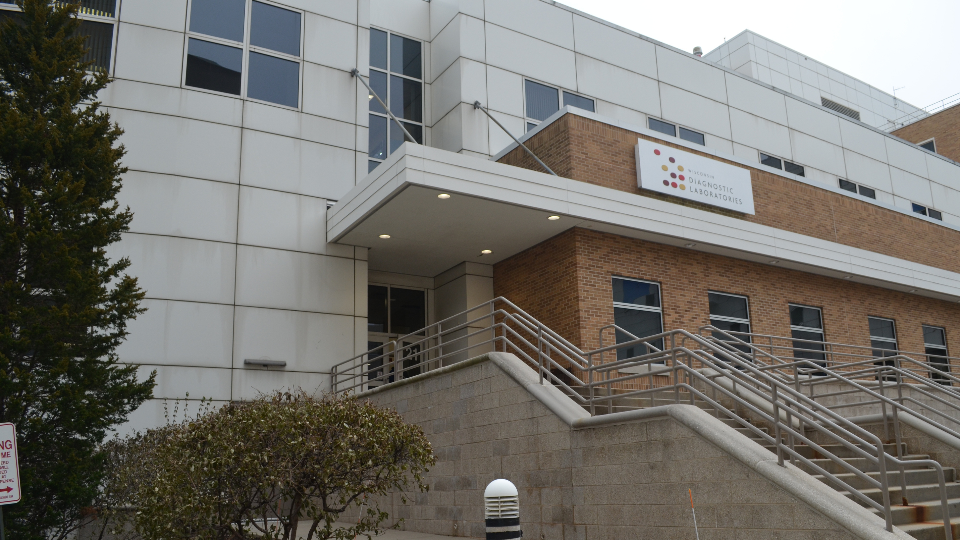
THANK
YOU

