Slide 1
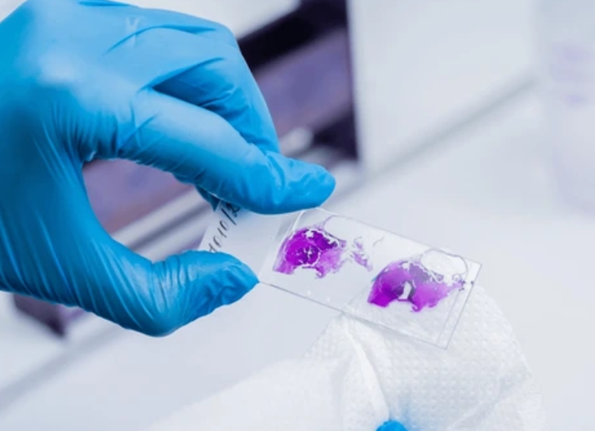
The Exciting World of Histology

Slide 2
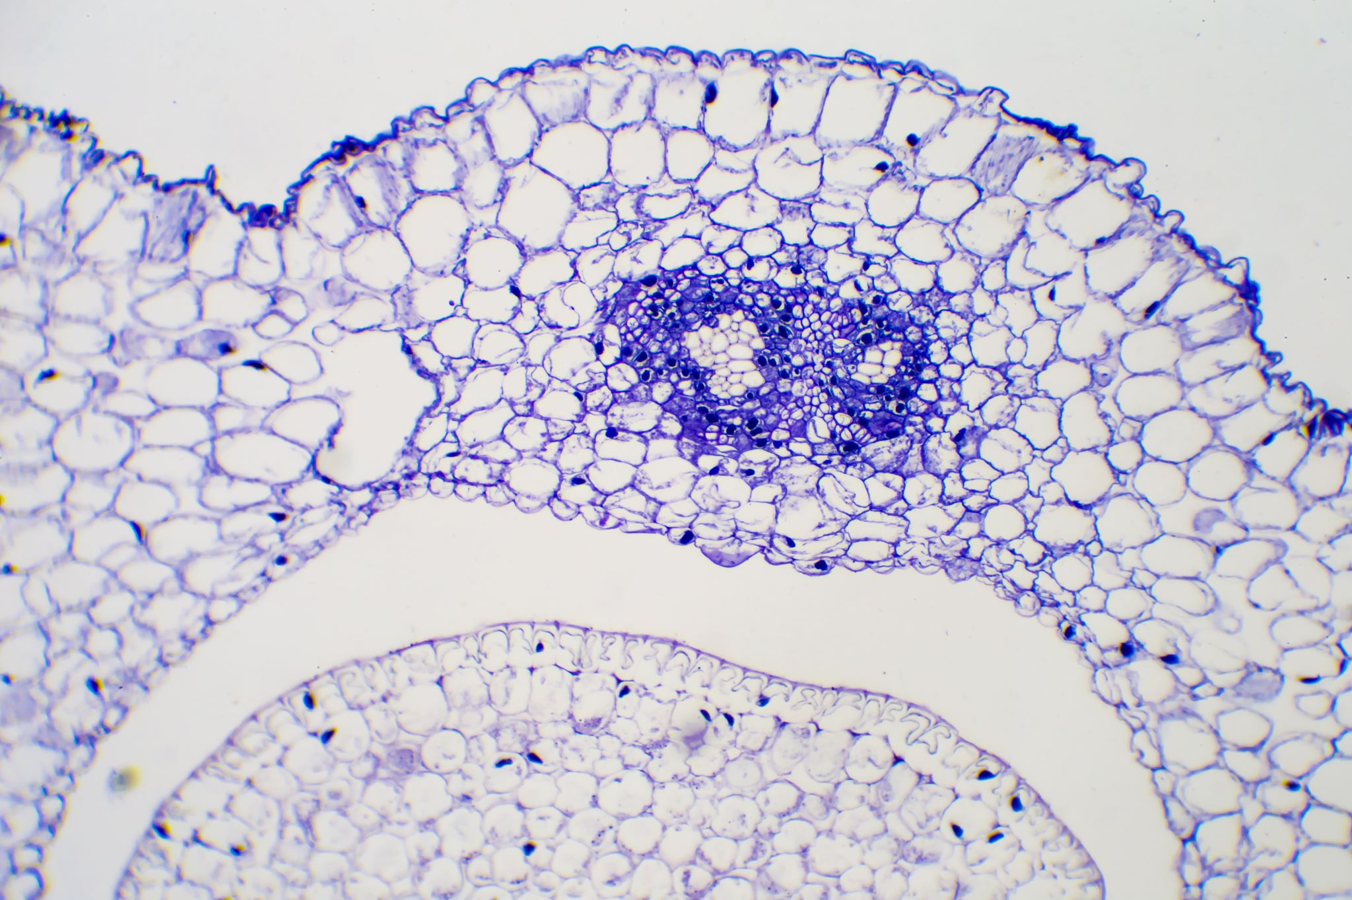
Field of Histology
Histology is a structural science focused on the study of tissues, including their cellular structure and chemical composition. Histotechnologists work under the guidance of a pathologist to prepare tissue specimens from human, animal, or plant sources for use in diagnosis, research, and education. The field of histology is continually evolving, with ongoing advances in technologies and techniques.
What is Histology?
Are you interested in biology, medicine, and disease prevention? If so, you may want to explore histology—the microscopic study of cells and tissues in humans, animals, and plants. Closely linked to cell biology, histology focuses on understanding tissue structure and function at the microscopic level. Histologists study how cells absorb nutrients, communicate with one another, and eliminate waste, as well as how abnormal or cancerous cells behave. This knowledge helps support the prevention, diagnosis, and treatment of different diseases.

Slide 3
Why is Histology Important?
Histology is the study of cells as seen under a microscope. It plays a vital role in medicine because it is a key tool used to diagnose disease. Many conditions first appear at the cellular level, including numerous cancers, as well as diseases affecting bone, connective tissue, blood vessels, the liver, and the kidneys, all of which can be accurately identified through histological methods. Histology enables detailed examination of the structure and makeup of tissues throughout the body, including muscle, bone, connective tissue, and organs. A microscope can reveal a wealth of information about health and disease at the cellular level.

Slide 4
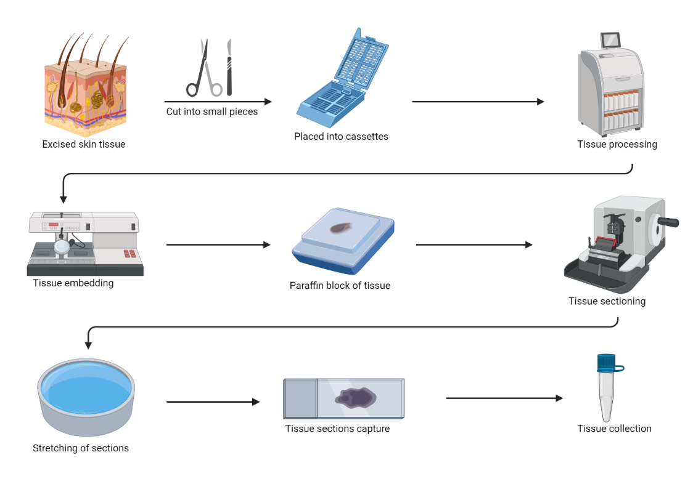
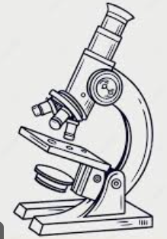
Histology Laboratory Workflow
Microscopic review
Notes:
https://youtu.be/sBfA30Ouc8w

Slide 5
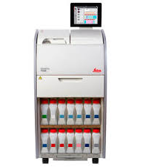
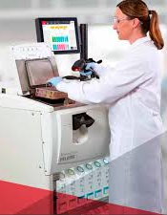
Tissue Processing
Most tissue processors are filled with different Reagents that are used to remove water from patient tissues. Water is removed from the tissue and replaced with melted paraffin wax. The wax infiltrates the tissue and provides the necessary support when cutting the tissue into thin sectioned which will eventually be placed on microscopic slides and examined under a microscope.

Slide 6
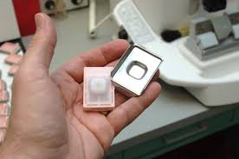
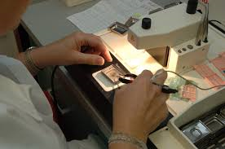
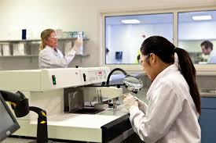
Embedding
Before the wax permeated tissue can by cut it is placed in a larger wax filled mold used for additional holding support during sectioning

Slide 7
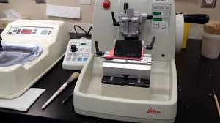
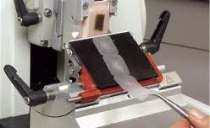
Microtomy
The waxed tissue is mounted onto an instrument called a Microtome. A sharp blade is used to cut sections of the tissue embedded in the wax block. These sections are cut one after another to form a ribbon, which is floated on warm water to soften and flatten tissue sections. These sections are then placed on a microscopic slide. The process can be performed by a Histology Technologists.

Slide 8
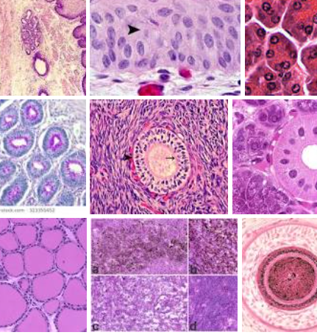
Staining
Staining causes tissue components to change colors when brought into contact with different chemicals. In addition to dyes, antibodies are reacted with tissues to identify specific tumor cell lines with a method called Immunohistochemistry. This technique is critical to guiding the patient’s physician in selecting the most effective tumor treatment. When staining is completed, the tissue section is ready for examination under a microscope by a pathologist. Without staining techniques, many tissue components would remain invisible.

Slide 9
Key Roles & Responsibilities within the Histology laboratory
Pathologist
Pathologist Assistant
Histology Technician/Technologist

Slide 10

Pathologist
A Pathologist is a medical doctor who specializes in diagnosing diseases by examining tissues, cells, and body fluids. They study samples under a microscope and use laboratory tests to determine the cause of illness, track how a disease is progressing, and help guide treatment decisions. Pathologists play a key role in diagnosing conditions such as infections, cancers, and autoimmune diseases, often working behind the scenes as part of a healthcare team.
Notes:
https://www.youtube.com/watch?v=j7P4U7sls7k

Slide 11
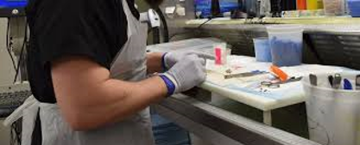
Pathologist Assistant
Tissue specimens taken from routine surgical cases, autopsies, or other scientific investigations are examined, described and trimmed to proper size. This process is referred to as “grossing”. The resulting specimens are preserved by placing them in solutions designed to prevent decomposition of the tissue. This procedure is performed by a Pathologist Assistant and/or a Technologists.
Notes:
https://www.youtube.com/watch?v=j7P4U7sls7k

Slide 12
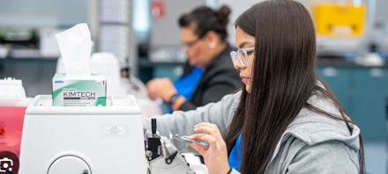
Histology Technician/ Technologist
Histotechnicians (HTs) and Histotechnologists (HTLs) have closely related roles and responsibilities within the histology laboratory. While HTs focus on preparing tissue samples, HTLs typically have more advanced education and are qualified to perform more complex testing, troubleshoot technical issues, and take on supervisory responsibilities. Both roles prepare human tissue samples into thin sections mounted on microscope slides, enabling pathologists to diagnose disease.
Notes:
https://www.youtube.com/watch?v=j7P4U7sls7k

